Slide 1

CSCI 476: Computer Security
Lecture 4: Operating Systems Review
Reese Pearsall
Spring 2023
*all images are stolen from the internet
https://www.cs.montana.edu/pearsall/classes/spring2023/476/main.html

Slide 2
Announcements
Lab 0 due Sunday at 11:59 PM
No in-person lecture on Wednesday 2/1

Slide 3

Announcements

Slide 4

Operating Systems Review
To understand the technical aspects of security, we must have a good understanding of how computers work
operating systems

Slide 5
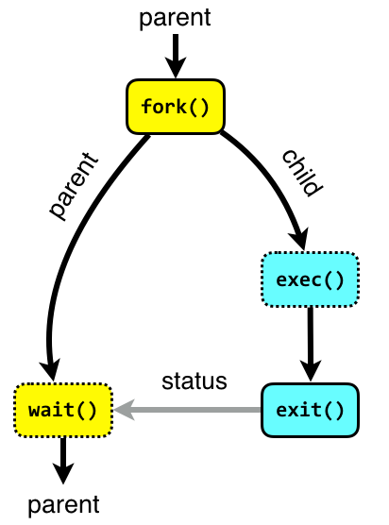
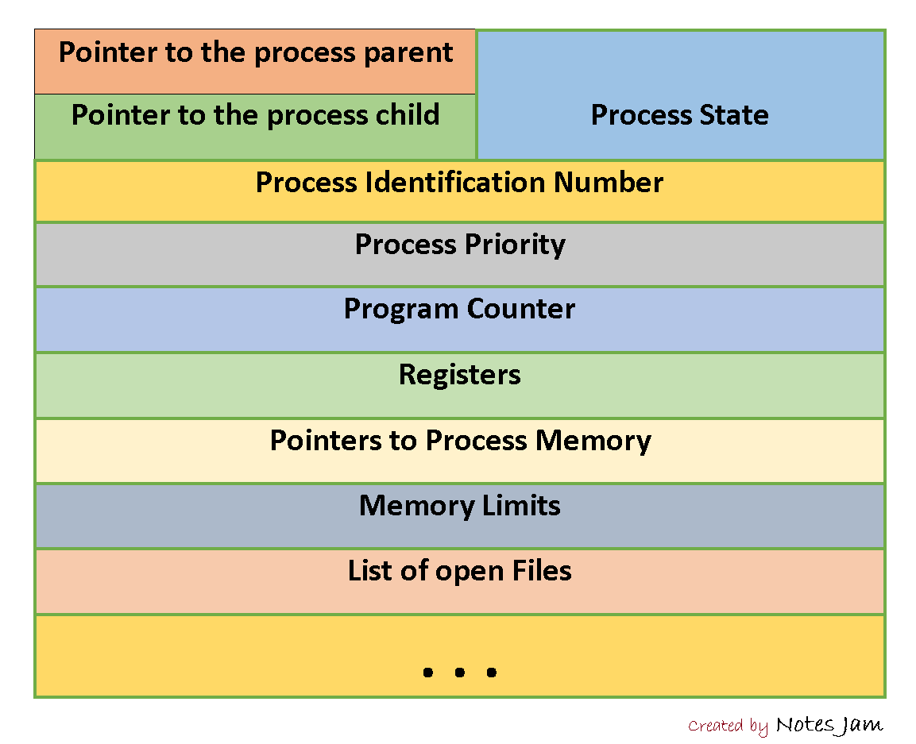
A process is an instance of a running program on a computer
All processes have the following data while they are running:
Executable Code
2. Associated Data
3. Execution Context/Bookkeeping information
(info that the OS needs to handle the process)
Program is now running as a process
./hello_world
Fork() and exec()

Slide 6
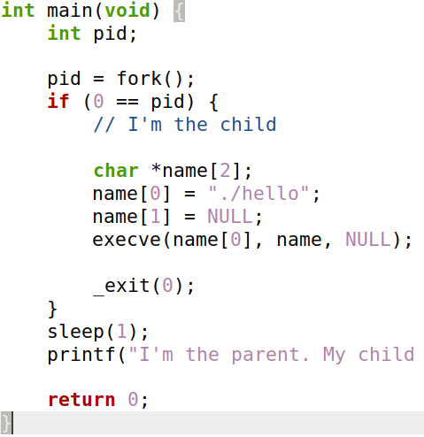
Demo time!
int main(void) {
int pid;
pid = fork();
if (0 == pid) {
// I'm the child
printf("Hi, I'm the child. \n");
}
sleep(1);
// we could wait() here
printf("I'm the parent.);
return 0;
}

Slide 7





The jobs of an Operating System
1. Process Manager
2. Interface Manager
3. Memory Manager
4. Traffic Manager
5. Illusion Manager
“The Coach”
“The Bouncer”
“The Farmer”
“The Judge”
“The Illusionist”

Slide 8
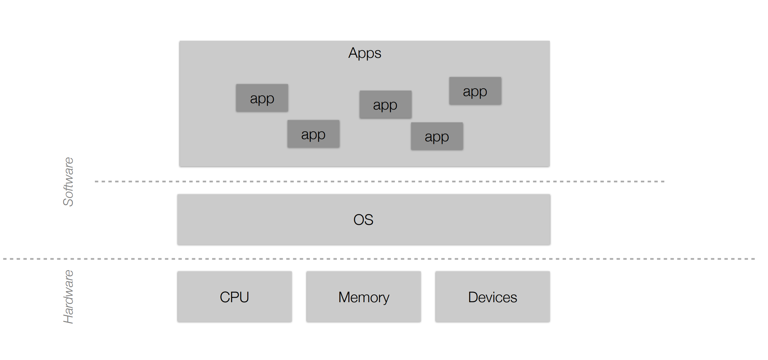
Operating Systems Review

Slide 9


Operating Systems Review
Responsibilities of the OS?
Interface Manager
Manages communication between apps and hardware

Slide 10

Operating Systems Review
Responsibilities of the OS?
Interface Manager
Manages communication between apps and hardware
Process Manager
Manages how processes are structured and how to handle many processes running at once

Slide 11

Operating Systems Review
Responsibilities of the OS?
Interface Manager
Manages communication between apps and hardware
Process Manager
Manages how processes are structured and how to handle many processes running at once
Traffic Manager
Manages which programs should be executed by the CPU

Slide 12
Operating Systems Review
Responsibilities of the OS?
Interface Manager
Manages communication between apps and hardware
Process Manager
Manages how processes are structured and how to handle many processes running at once
Traffic Manager
Manages which programs should be executed by the CPU
Memory Manager
Manages how physical memory is utilized

Slide 13

Operating Systems Review
Responsibilities of the OS?
Interface Manager
Manages communication between apps and hardware
Process Manager
Manages how processes are structured and how to handle many processes running at once
Traffic Manager
Manages which programs should be executed by the CPU
Memory Manager
Manages how physical memory is utilized

Slide 14




Operating Systems Review
Responsibilities of the OS?
Interface Manager
Manages communication between apps and hardware
How does an application get access to a computer's resources?

Slide 15
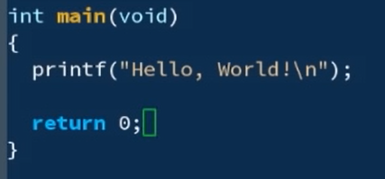
Syscalls
Applications evoke operating system defined functions, or system calls (syscalls), to access computing resources

Slide 16
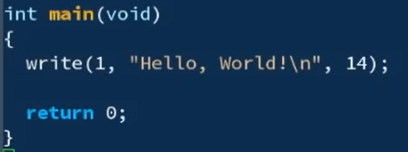
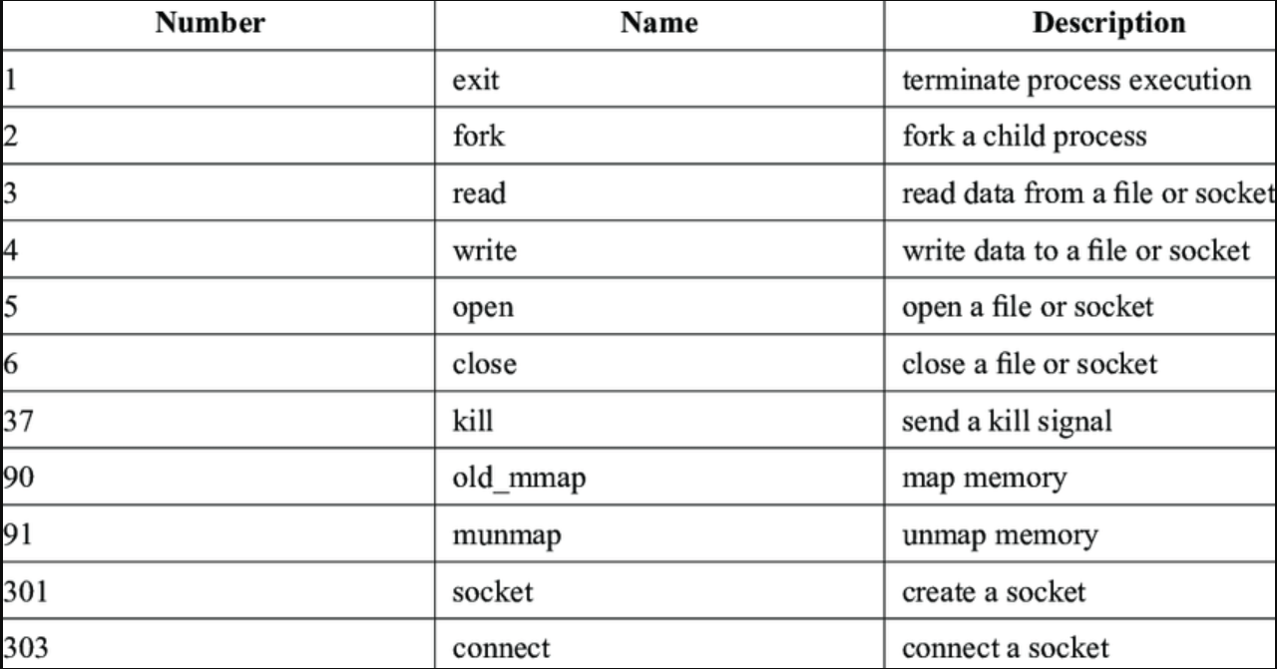
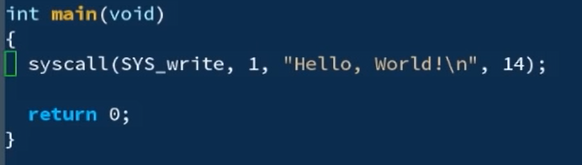
Syscalls
Applications evoke operating system defined functions, or system calls (syscalls), to access computing resources

Slide 17
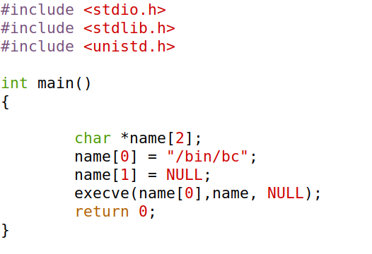
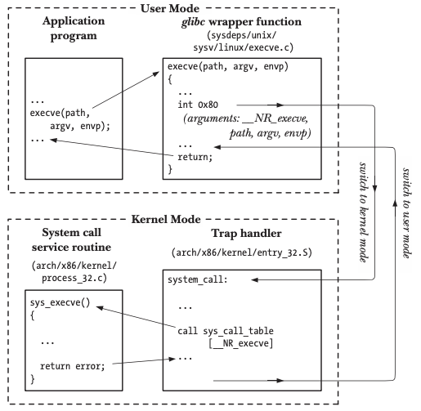
Syscalls
Applications evoke operating system defined functions, or system calls (syscalls), to access computing resources
syscall

Slide 18
Syscalls
Applications evoke operating system defined functions, or system calls (syscalls), to access computing resources
Libraries handle the system calls for us
syscall

Slide 19
Syscalls
Applications evoke operating system defined functions, or system calls (syscalls), to access computing resources
Libraries handle the system calls for us
syscall
The operating system have hundreds of different syscalls, and different syscalls have different parameters, we need a way to distinguish them
EAX
EBX
ECX
EDX

Slide 20
Syscalls
Applications evoke operating system defined functions, or system calls (syscalls), to access computing resources
Libraries handle the system calls for us
syscall
The operating system have hundreds of different syscalls, and different syscalls have different parameters, we need a way to distinguish them
EAX
System Call Number
EBX
Address of “/bin/bc”
ECX
0 or 1
Environment variables
The OS will look at the values at certain registers!
EDX
INT 0x80
send trap to kernel and invoke the syscall

Slide 21
Syscalls
Applications evoke operating system defined functions, or system calls (syscalls), to access computing resources
Libraries handle the system calls for us
syscall
EAX
System Call Number
EBX
Address of “/bin/bc”
ECX
0 or 1
Environment variables
EDX
INT 0x80
send trap to kernel and invoke the syscall

Slide 22
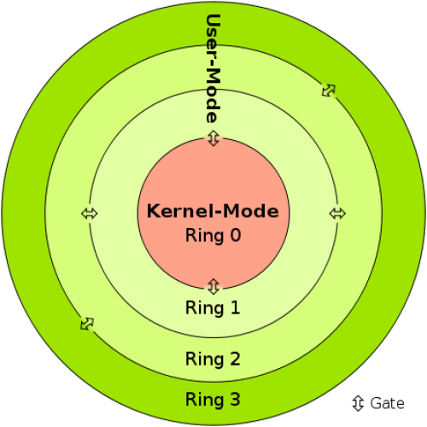
Syscalls
All applications run in user mode.
The code has no ability to directly access hardware
Code running in user mode must use API/syscalls to access hardware and memory

Slide 23
Syscalls
All applications run in user mode.
The code has no ability to directly access hardware
Code running in user mode must use API/syscalls to access hardware and memory
Code running in kernel-mode has complete, unrestricted access to computer resources
Reserved for the lowest-level trusted functions of the operating system

Slide 24
Syscalls
The collective functionality and services of the OS that manages the computer and its resources is called the kernel

Slide 25
Syscalls
Applications evoke operating system defined functions, or system calls (syscalls), to access computing resources
Libraries handle the system calls for us
syscall
EAX
System Call Number
EBX
Address of “/bin/bc”
ECX
0 or 1
Environment variables
EDX
INT 0x80
send trap to kernel and invoke the syscall

Slide 26

Syscalls
Applications evoke operating system defined functions, or system calls (syscalls), to access computing resources
Libraries handle the system calls for us
syscall
EAX
System Call Number
EBX
Address of “/bin/bc”
ECX
0 or 1
Environment variables
EDX
INT 0x80
send trap to kernel and invoke the syscall

Slide 27
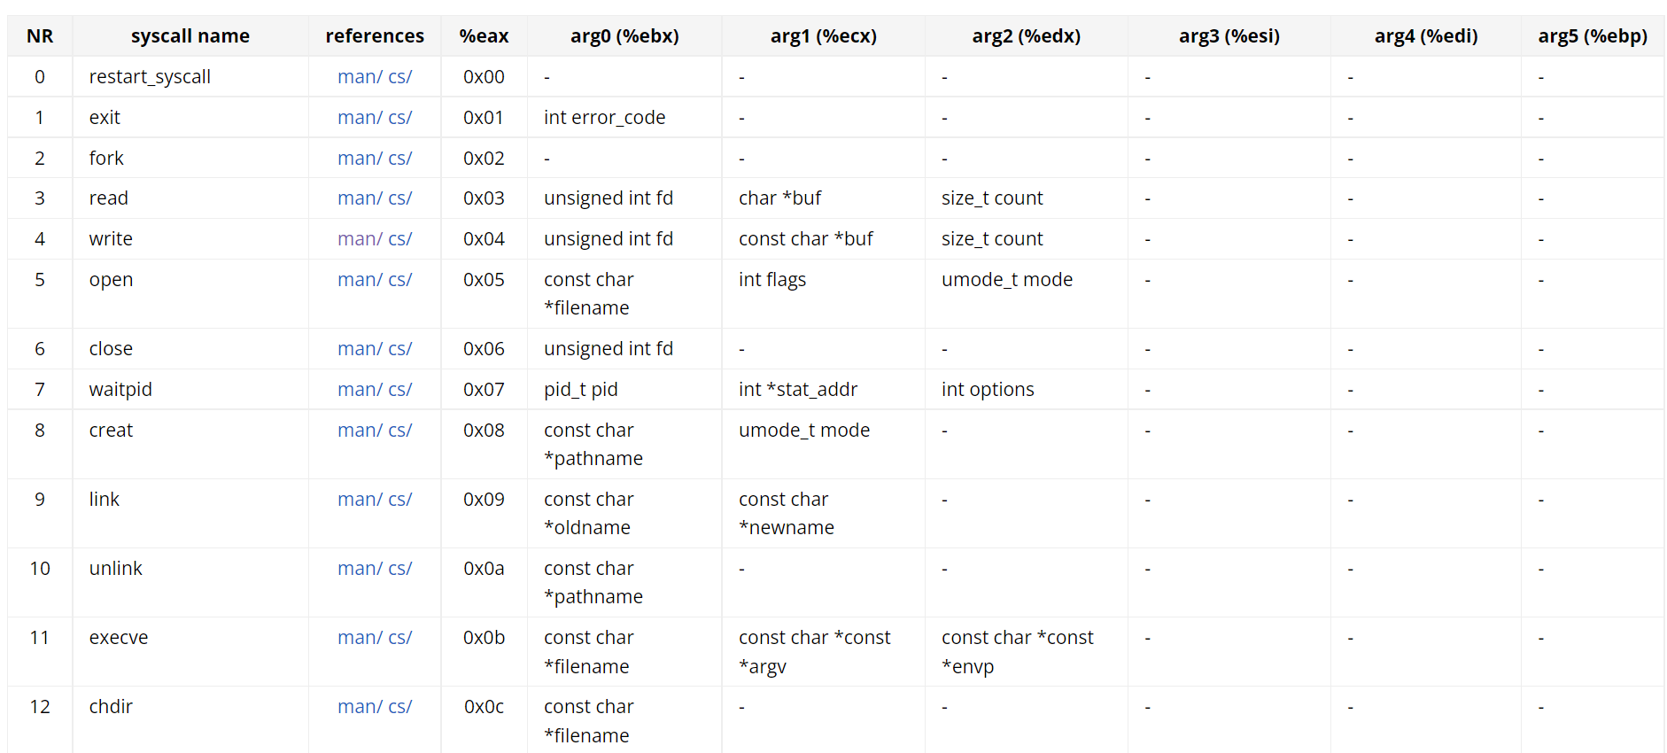

Syscalls
Applications evoke operating system defined functions, or system calls (syscalls), to access computing resources
Libraries handle the system calls for us
syscall
EAX
System Call Number
EBX
Address of “/bin/bc”
ECX
0 or 1
Environment variables
EDX
INT 0x80
send trap to kernel and invoke the syscall

Slide 28
Syscalls
Applications evoke operating system defined functions, or system calls (syscalls), to access computing resources
Libraries handle the system calls for us
https://chromium.googlesource.com/chromiumos/docs/+/master/constants/syscalls.md#x86-32_bit
syscall
EAX
System Call Number
EBX
Address of “/bin/bc”
ECX
0 or 1
Environment variables
EDX
INT 0x80
send trap to kernel and invoke the syscall

Slide 29
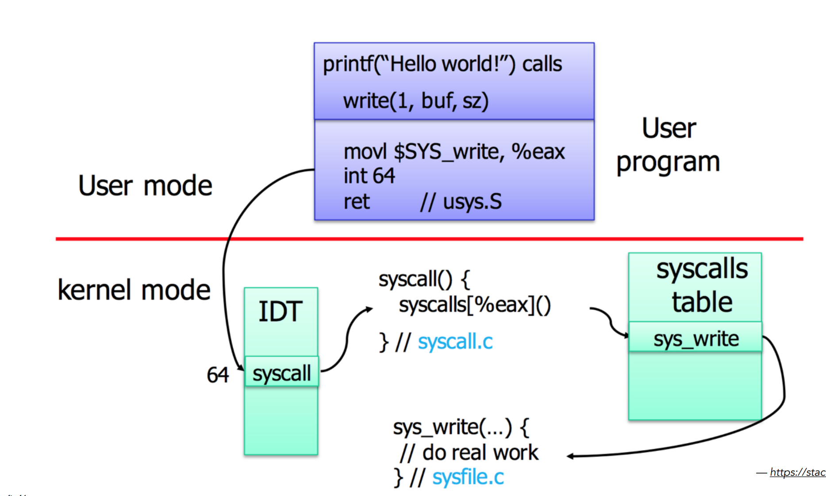
Syscalls

Slide 30





Applications Layout in Memory
Process Manager
Manages how processes are structured and how to handle many processes running at once
How does a program get loaded into memory?

Slide 31





Applications Layout in Memory
Process Manager
Manages how processes are structured and how to handle many processes running at once
How does a program get loaded into memory?
An active program running on a computer is called a process

Slide 32

Applications Layout in Memory
Process Manager
Manages how processes are structured and how to handle many processes running at once
What does this look like?
Executable Code
2. Associated Data
3. Execution Context/Bookkeeping information

Slide 33

Applications Layout in Memory
Process Manager
Manages how processes are structured and how to handle many processes running at once
What does a program look like in memory?

Slide 34
Applications Layout in Memory
Process Manager
Manages how processes are structured and how to handle many processes running at once
0xFFFFFFFFFFFFFFFFFFFFFFFFF
Text
Executable instructions
Text Segment- binary executable instructions for the process
What does a program look like in memory?
0x00000000000000000000000

Slide 35
Applications Layout in Memory
Process Manager
Manages how processes are structured and how to handle many processes running at once
0xFFFFFFFFFFFFFFFFFFFFFFFFF
Data
Static variables with values
Text
Executable instructions
Data Segment- Static variables initialized by the programmer
What does a program look like in memory?
0x00000000000000000000000

Slide 36
Applications Layout in Memory
Process Manager
Manages how processes are structured and how to handle many processes running at once
0xFFFFFFFFFFFFFFFFFFFFFFFFF
BSS
Static variables without a value
Data
Static variables with values
Text
Executable instructions
BSS Segment- contains statically allocated variables that are declared, but have not been assigned a value yet
What does a program look like in memory?
0x00000000000000000000000

Slide 37
Applications Layout in Memory
Process Manager
Manages how processes are structured and how to handle many processes running at once
0xFFFFFFFFFFFFFFFFFFFFFFFFF
Heap
Space for dynamically allocated memory
BSS
Static variables without a value
Data
Static variables with values
Text
Executable instructions
Heap- memory set aside for dynamic allocation (e.g. malloc). Grows “up” as more memory is allocated
What does a program look like in memory?
0x00000000000000000000000

Slide 38
Applications Layout in Memory
Process Manager
Manages how processes are structured and how to handle many processes running at once
0xFFFFFFFFFFFFFFFFFFFFFFFFF
Stack
Space for function variables (temporary)
Heap
Space for dynamically allocated memory
BSS
Static variables without a value
Data
Static variables with values
Text
Executable instructions
Stack – memory for storing function variables. Grows “down” as additional functions are called
What does a program look like in memory?
0x00000000000000000000000

Slide 39





Applications Layout in Memory
Process Manager
Manages how processes are structured and how to handle many processes running at once
0xFFFFFFFFFFFFFFFFFFFFFFFFF
OS Kernel Space
Stack
Space for function variables (temporary)
Heap
Space for dynamically allocated memory
BSS
Static variables without a value
Data
Static variables with values
Text
Executable instructions
Executable Code
2. Associated Data
3. Execution Context/Bookkeeping information
0x00000000000000000000000

Slide 40
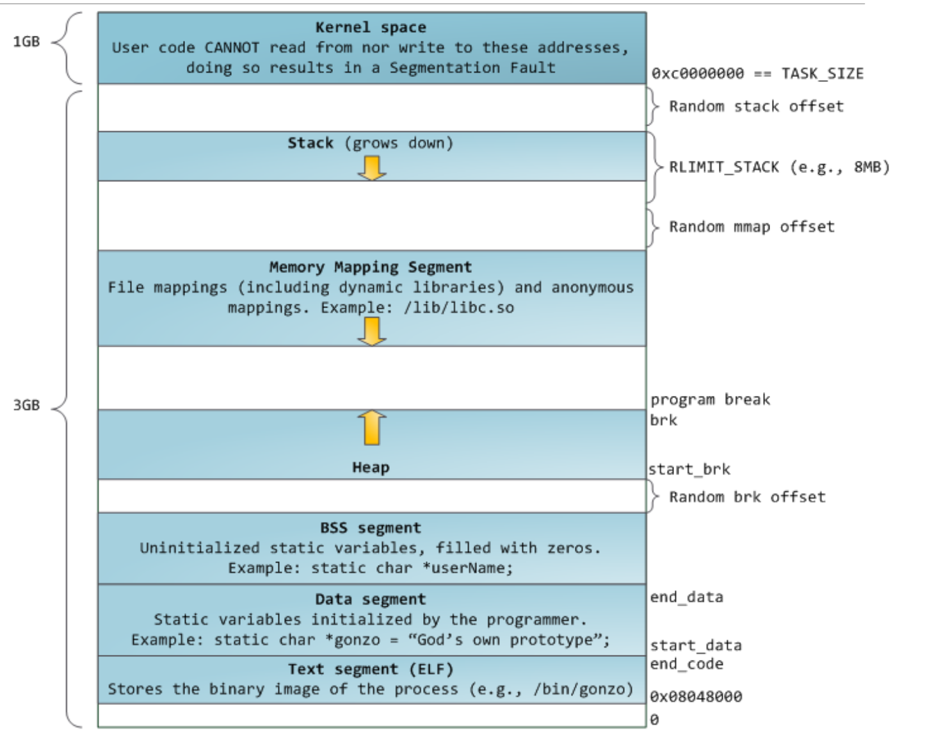
Applications Layout in Memory
Demo?

Slide 41
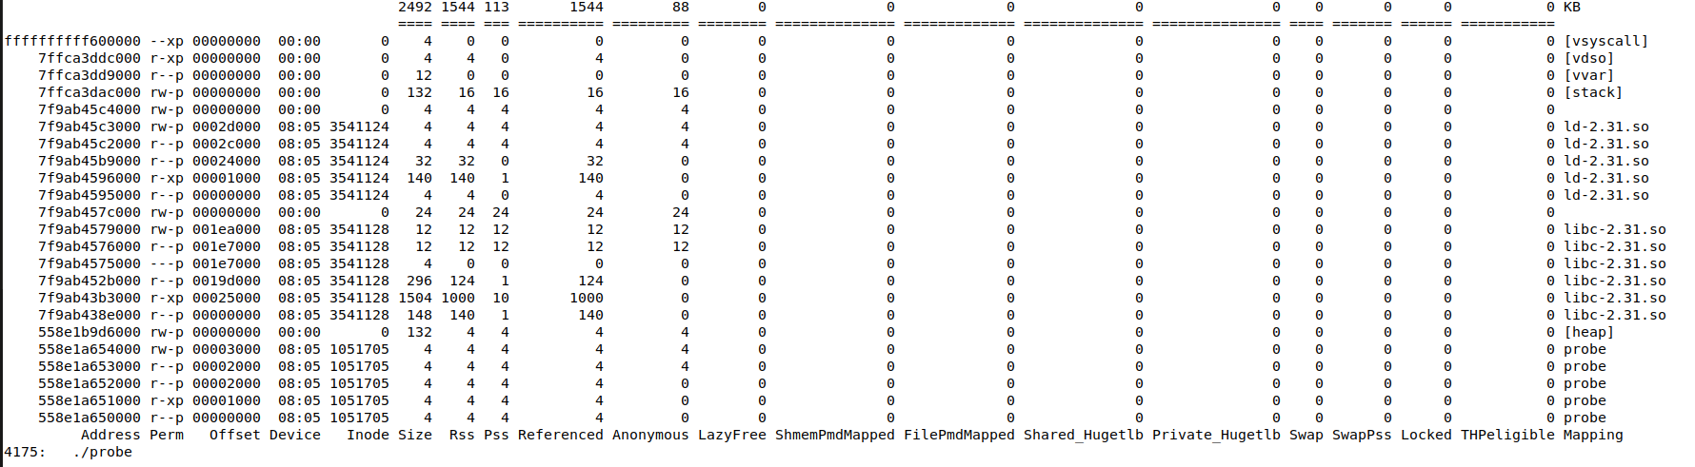
Applications Layout in Memory
Ouput of pmap (process mapping tool)

Slide 42
Applications Layout in Memory
Ouput of pmap (process mapping tool)
“probe” is the name of our executable

Slide 43
Applications Layout in Memory
Ouput of pmap (process mapping tool)
BSS
Static variables without a value
Data
Static variables with values
“probe” is the name of out executable
This section is executable “x”
Text
Executable instructions

Slide 44
Applications Layout in Memory
Ouput of pmap (process mapping tool)
Heap
Space for dynamically allocated memory
Beginning of heap
BSS
Static variables without a value
Data
Static variables with values
“probe” is the name of out executable
This section is executable “x”
Text
Executable instructions

Slide 45
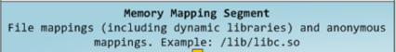
Applications Layout in Memory
Ouput of pmap (process mapping tool)
Heap
Space for dynamically allocated memory
Beginning of heap
BSS
Static variables without a value
Data
Static variables with values
“probe” is the name of out executable
This section is executable “x”
Text
Executable instructions

Slide 46
Applications Layout in Memory
Ouput of pmap (process mapping tool)
Stack
Space for function variables (temporary)
Beginning of stack
Heap
Space for dynamically allocated memory
Beginning of heap
BSS
Static variables without a value
Data
Static variables with values
“probe” is the name of out executable
This section is executable “x”
Text
Executable instructions

Slide 47
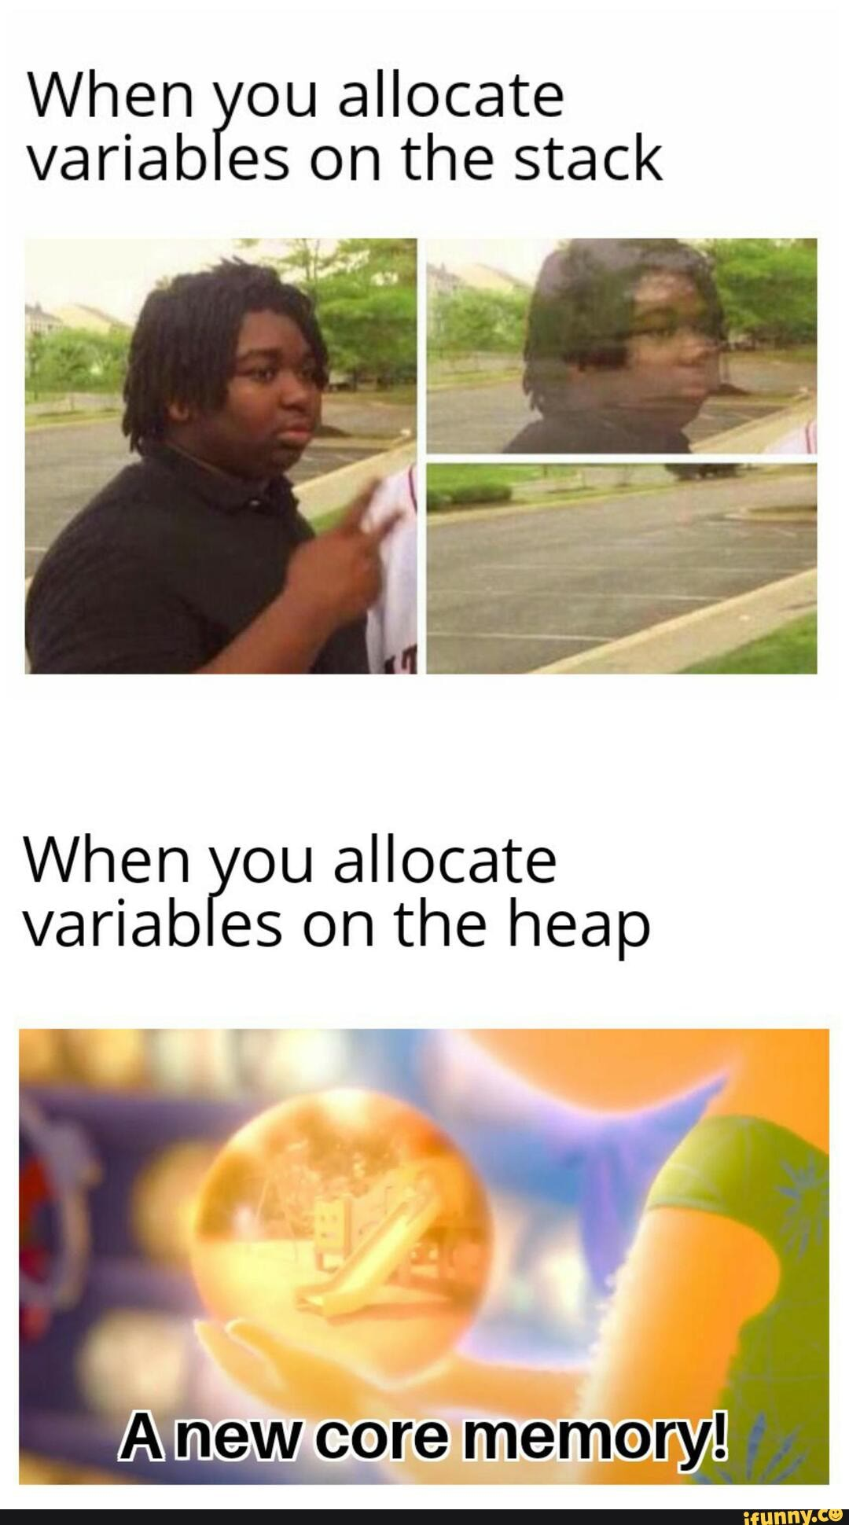
Applications Layout in Memory
Ouput of pmap (process mapping tool)
Stack
Space for function variables (temporary)
Beginning of stack
Heap
Space for dynamically allocated memory
Beginning of heap
BSS
Static variables without a value
Data
Static variables with values
“probe” is the name of out executable
This section is executable “x”
Text
Executable instructions

Slide 48
Applications Layout in Memory
Ouput of pmap (process mapping tool)
OS Kernel Space
Stack
Space for function variables (temporary)
Beginning of stack
Heap
Space for dynamically allocated memory
Beginning of heap
BSS
Static variables without a value
Data
Static variables with values
“probe” is the name of out executable
This section is executable “x”
Text
Executable instructions

Slide 49
Applications Layout in Memory
Ouput of pmap (process mapping tool)
OS Kernel Space
Stack
Space for function variables (temporary)
Heap
Space for dynamically allocated memory
BSS
Static variables without a value
Data
Static variables with values
Text
Executable instructions

Slide 50
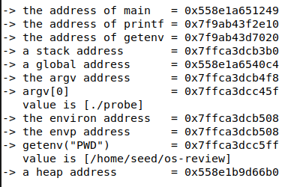
Applications Layout in Memory
Ouput of pmap (process mapping tool)

Slide 51
Applications Layout in Memory
Ouput of pmap (process mapping tool)
Where is “main” located in memory?

Slide 52


Applications Layout in Memory
Ouput of pmap (process mapping tool)
Where is “main” located in memory?
main is code in our program, so it goes inside the text segment

Slide 53
Applications Layout in Memory
Ouput of pmap (process mapping tool)
Where is “printf” located in memory?

Slide 54


Applications Layout in Memory
Ouput of pmap (process mapping tool)
Where is “printf” located in memory?
printf is executable code from a shared library (libc) so we are in the memory mapping segment!

Slide 55
Applications Layout in Memory
Ouput of pmap (process mapping tool)
Where is “argv” located in memory?
argv is an array that holds the command line parameters passed into this program

Slide 56


Applications Layout in Memory
Ouput of pmap (process mapping tool)
Where is “argv” located in memory?
argv is the argument to the main function, so we are in the stack!

Slide 57
Applications Layout in Memory
Process C
Process B
Process X
Process A
We have many programs that are actively running on our computer

Slide 58
Applications Layout in Memory
8GB
20GB
Process C
Process B
Process X
Process A
We have many programs that are actively running on our computer
Process P
What if we have a program that is bigger than out entire main memory?

Slide 59
Applications Layout in Memory
8GB
20GB
Process C
Process B
Process X
Process A
We have many programs that are actively running on our computer
Process P
What if we have a program that is bigger than out entire main memory?
Does our computer crash?

Slide 60

Memory management
8GB
Process C
Process B
Process X
Process A
Virtual Memory uses secondary storage to give programs the illusion that they have infinite storage
Secondary Storage

Slide 61
Memory management
8GB
Process C
Process B
Process X
Process A
Virtual Memory uses secondary storage to give programs the illusion that they have infinite storage
Secondary Storage
We split the process into smaller pages. Load pages into memory only when needed
Process P
Process X

Slide 62
Memory management
8GB
Process C
Process P
Process B
Process X
Process A
Virtual Memory uses secondary storage to give programs the illusion that they have infinite storage
Secondary Storage
We split the process into smaller pages. Load pages into memory only when needed
Process P
Process X

Slide 63
Memory management
8GB
Process C
Process P
Process B
Process X
Process A
Process P
Virtual Memory uses secondary storage to give programs the illusion that they have infinite storage
Secondary Storage
We split the process into smaller, fixed-size, pages. Load pages into memory only when needed
Process P
Process X

Slide 64
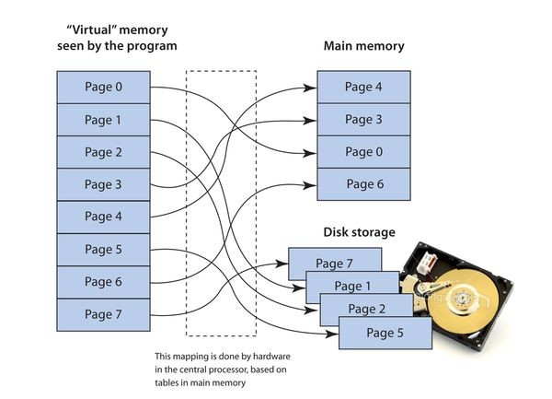
Memory management
Virtual Memory uses secondary storage to give programs the illusion that they have infinite storage
We split the process into smaller, fixed-size, pages. Load pages into memory only when needed
Constantly swapping stuff in and out of main memory

Slide 65
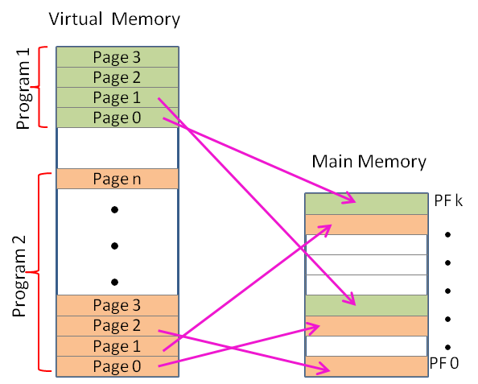
Memory management
Virtual Memory uses secondary storage to give programs the illusion that they have infinite storage
We split the process into smaller, fixed-size, pages. Load pages into memory only when needed
A process in memory is not contiguous

Slide 66

Memory management
Virtual Memory uses secondary storage to give programs the illusion that they have infinite storage
Virtual addresses!
Physical addresses!
We split the process into smaller, fixed-size, pages. Load pages into memory only when needed
A process in memory is not contiguous
In probe.c, we are seeing virtual addresses!
Internal fragmentation vs external fragmentation

Slide 67
OS Review
Process Manager
Manages how processes are structured and how to handle many processes running at once
Interface Manager
Manages communication between apps and hardware
Memory Manager
Manages how physical memory is utilized

Slide 68


Illusion Manager
Gives applications the illusion that they have infinite storage and resources
Traffic Manager
Manages which programs should be executed by the CPU
“Unlimited RAM”
Process A
(Ready)
Process B
(Urgent)
CPU
Process C
(Ready)
HDD
Virtual Memory
Process D
(Blocked)

Slide 69
The jobs of an Operating System
1. Process Manager
2. Interface Manager
3. Memory Manager
4. Traffic Manager
5. Illusion Manager
“The Coach”
“The Bouncer”
“The Farmer”
“The Judge”
“The Illusionist”

